Slide 1

[Glossary Icon]
Start New Conversation
The Pathfinder Conversation Guide will help identify your customers alignment philosophy in Total Knee Arthroplasty (TKA).
Choose an option to get started.
Load Existing Conversation
Explore Kinematic Restoration
Compare Philosophies Tool
Challenger Selling Philosophy Questions
Notes:
Surgeons need to be able to create an account. Generic password to create account TXT auth
Only
Start New Conversation
Compare Philosophies Tool
Explore Kinematic Restoration
Compare Philosophies Tool – Select 1 – 4 of the philosophies and get a comparison in a modal
Explore Kinematic Restoration – Modal with list of embedded PDF / video etc
New Button – Challenger Selling Philosophy Questions (Filterable by topic list in red in the doc - List of Static Questions / Answers)

Slide 2
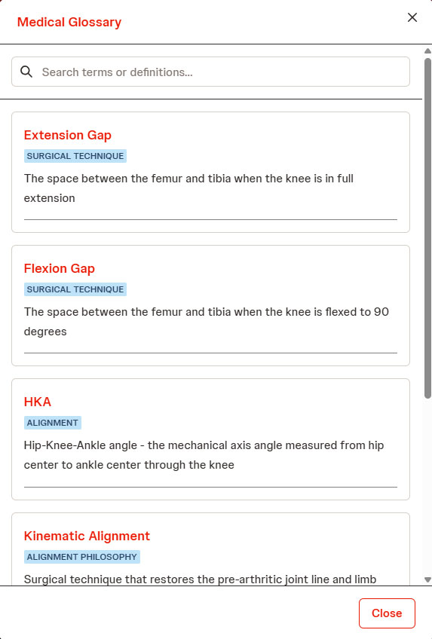
[Glossary Icon]
Start New Conversation
The Pathfinder Conversation Guide will help identify your customers alignment philosophy in Total Knee Arthroplasty (TKA).
Choose an option to get started.
Load Existing Conversation
Explore Kinematic Restoration
Compare Philosophies Tool
Challenger Selling Philosophy Questions
Notes:
Surgeons need to be able to create an account. Generic password to create account TXT auth
Only
Start New Conversation
Compare Philosophies Tool
Explore Kinematic Restoration
Compare Philosophies Tool – Select 1 – 4 of the philosophies and get a comparison in a modal
Explore Kinematic Restoration – Modal with list of embedded PDF / video etc
New Button – Challenger Selling Philosophy Questions (Filterable by topic list in red in the doc - List of Static Questions / Answers)

Slide 3
[Glossary Icon]
Create New Conversation
Surgeon name(s)
Affiliated hospital
Affiliated Ambulatory Surgery Center
The Pathfinder Conversation Guide will help identify your customers alignment philosophy in Total Knee Arthroplasty (TKA).
Choose an option to get started.
Start New Conversation
Date
Load Existing Conversation
[Default to current date]]
Review Content
Compare Philosophies Tool
Notes:
Add ASC Ambulatory Surgery Center
Current Alignment Dropdown + Don’t know
Add
Surgeon Knee Arthroplasty volume / year
< 50
<100
< 200
200
Is the surgeon currently using robotics Yes / No

Slide 4
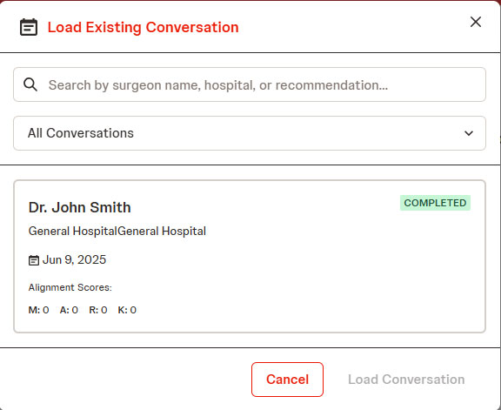
[Glossary Icon]
Load Existing Conversation
[List showing surgeon, hospital, and date and a way to select]
The Pathfinder Conversation Guide will help identify your customers alignment philosophy in Total Knee Arthroplasty (TKA).
Choose an option to get started.
Start New Conversation
Load Existing Conversation
Review Content
Compare Philosophies Tool

Slide 5

[Glossary Icon]
Are you willing to deviate from mechanical axis (0° HKA)?
Select one option:
Yes
No
Review / Edit Notes
Notes:
Yes= +1 KA / +1 iKA / +1 FA
No= +2 MA
Notes are per conversation. 1 Formattable textfiled
Add Progress Bar Add Next Back buttons

Slide 6


[Glossary Icon]
Your approach suggests:
[Suggested Approach]
Restart
Mechanical Alignment with balancing starts off with standard mechanical alignment that aims for a neutral HKA. The femur position is then adjusted to balance flexion and extension gaps. The tibia proximal resection depths are then adjusted if needed. This technique prioritizes minimizing femur and tibia deviation from neutral.
[SCATTER CHART / IMAGE(S) HERE]
Compare Philosophies Tool
Download Conversation
Explore Kinematic Restoration
Review / Edit Notes
Notes:
New Button – Challenger Selling Philosophy Questions (Filterable by topic list in red in the doc - List of Static Questions / Answers)
Explore Kji9nematic Restoraction – send link but button only shows site
Click here to dive intoi Kinematic restoration
Add References / Citations button – List of downloadable evidence.

